Slide 1
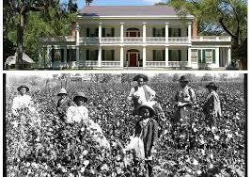
The Transatlantic Slave Trade: Slave Ships, Plantations, & Escape
Ms. Carey Socials 9

Slide 2
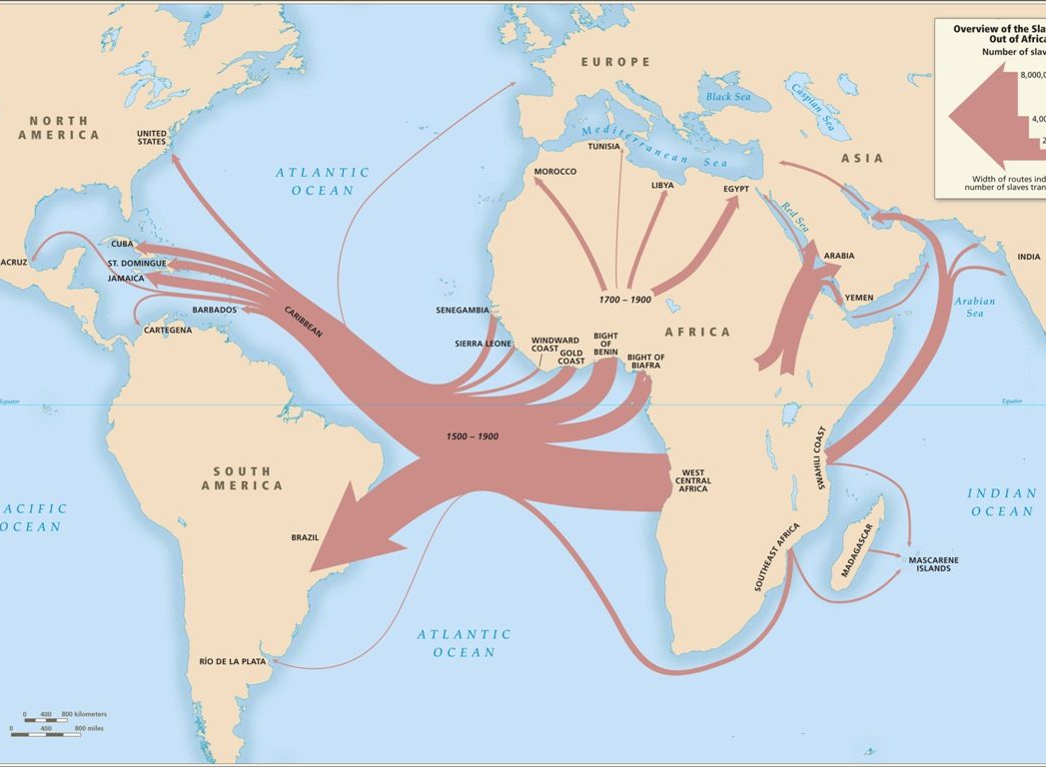
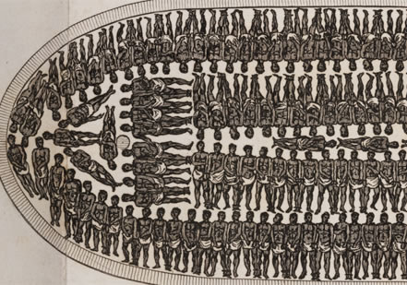
Slave Ships: The Middle Passage

Slide 3
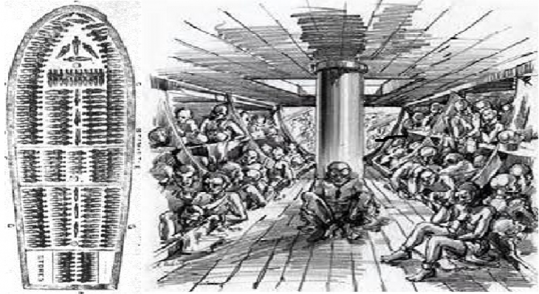

Slide 4
If you were ‘lucky enough’ to survive the Middle Passage… the risks were still huge:
Too many slaves survived?
They would be chained to an anchor and drowned off shore in order to avoid extra cargo taxes…

Slide 5
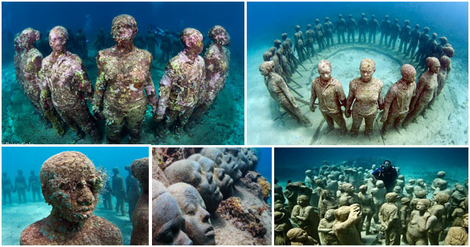

Slide 6
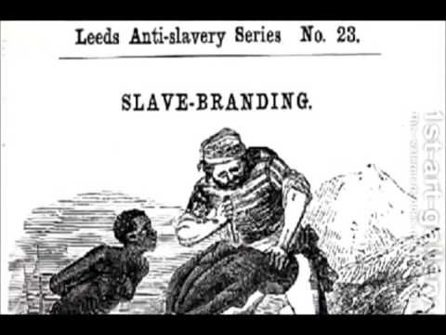
You survive and make it to shore:
You are branded like an animal and sold at auction to a plantation owner who would then own you.

Slide 8
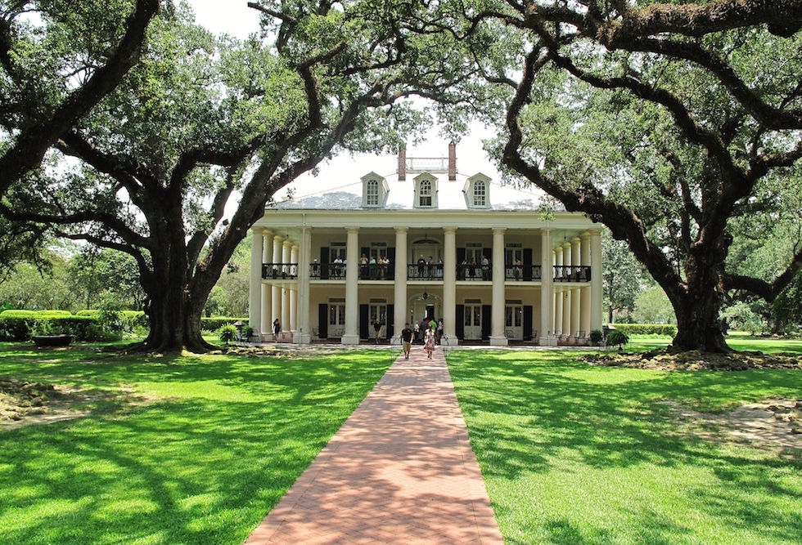
At the Plantation…
Hard Labour in the fields

Slide 9
Conditions for Slaves:

Slide 11
Brutal conditions

Slide 12
ESCAPE! – The Underground Railroad

Slide 13
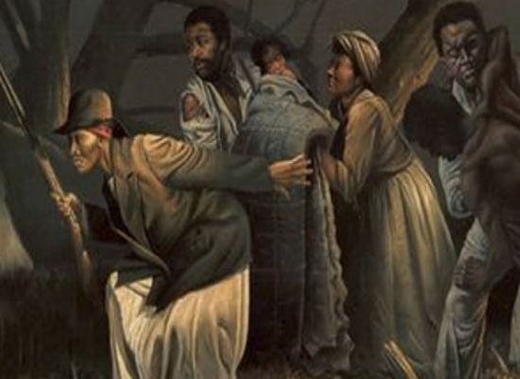
The Underground Railroad

Slide 14
Conductors of the Underground Railroad:
People who helped slaves escape and tried to help them get to Canada “The North Star” for freedom were called CONDUCTORS

Slide 15
Harriet Tubman -19 trips across the border in Canada - saved over 300 slaves herself!

Slide 16
Slave Quilts- Code & Directions to Canada!

Slide 17
Codes in the Quilts:

Slide 18
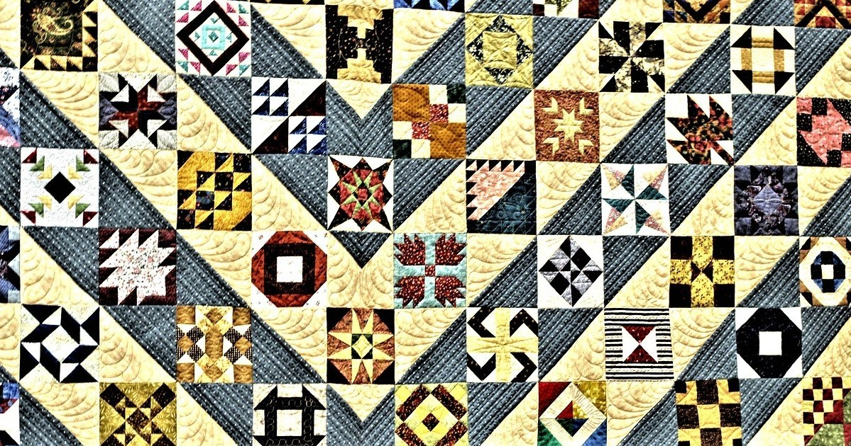

Slide 19
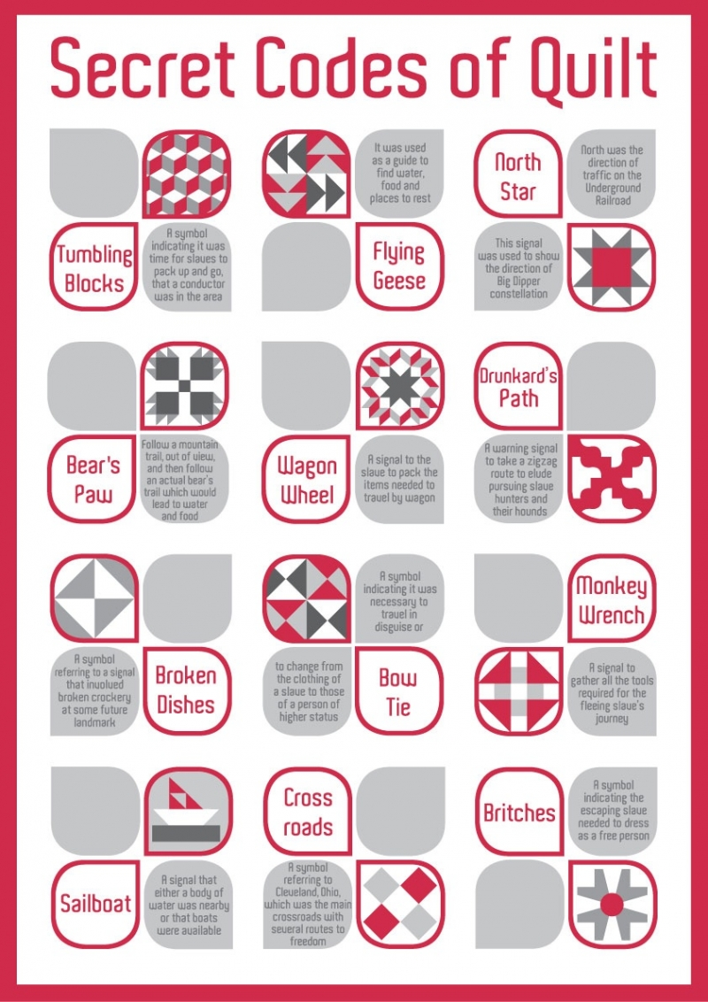
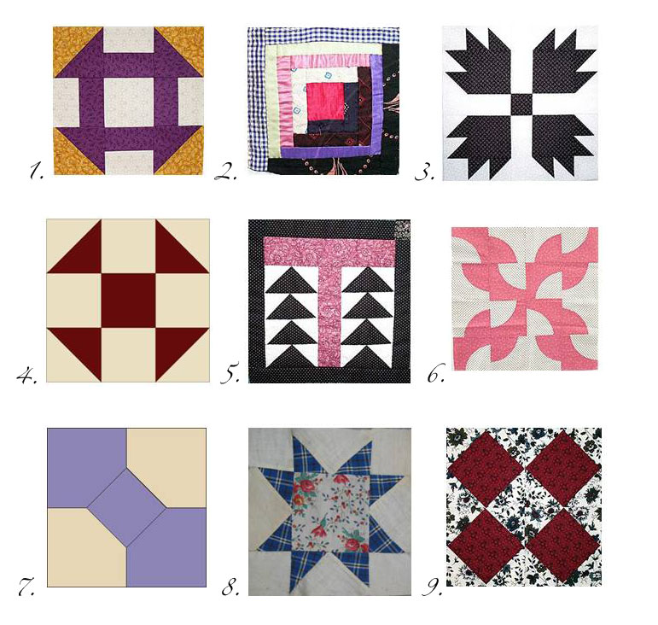

Slide 20
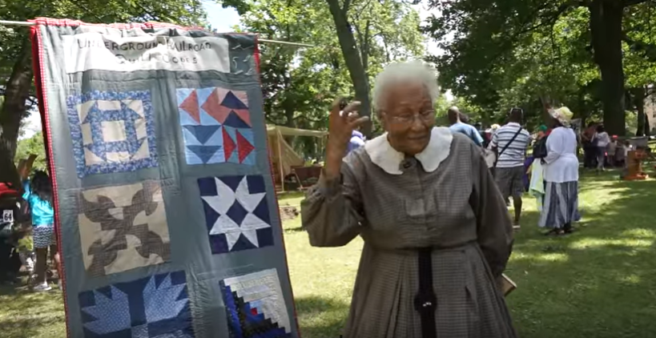
https://www.youtube.com/watch?v=PKFtJ_ZqfMY

